Slide 1
Value Stream Mapping (VSM)
v1.2

Slide 2

What is Value Stream Mapping (VSM)ping?
We typically define a value stream as a series of steps an organization undertakes to create and deliver value to customers.
A value stream therefore represents all the activities, workflows, controls and procedures required to deliver an outcome.
Mapping is a Lean technique that's primary purpose is to illustrate, analyze and improve the steps required to deliver a product or service.
The output of VSM should be a structured visual representation of all the steps of a process, necessary to deliver value from start to finish.

Slide 3
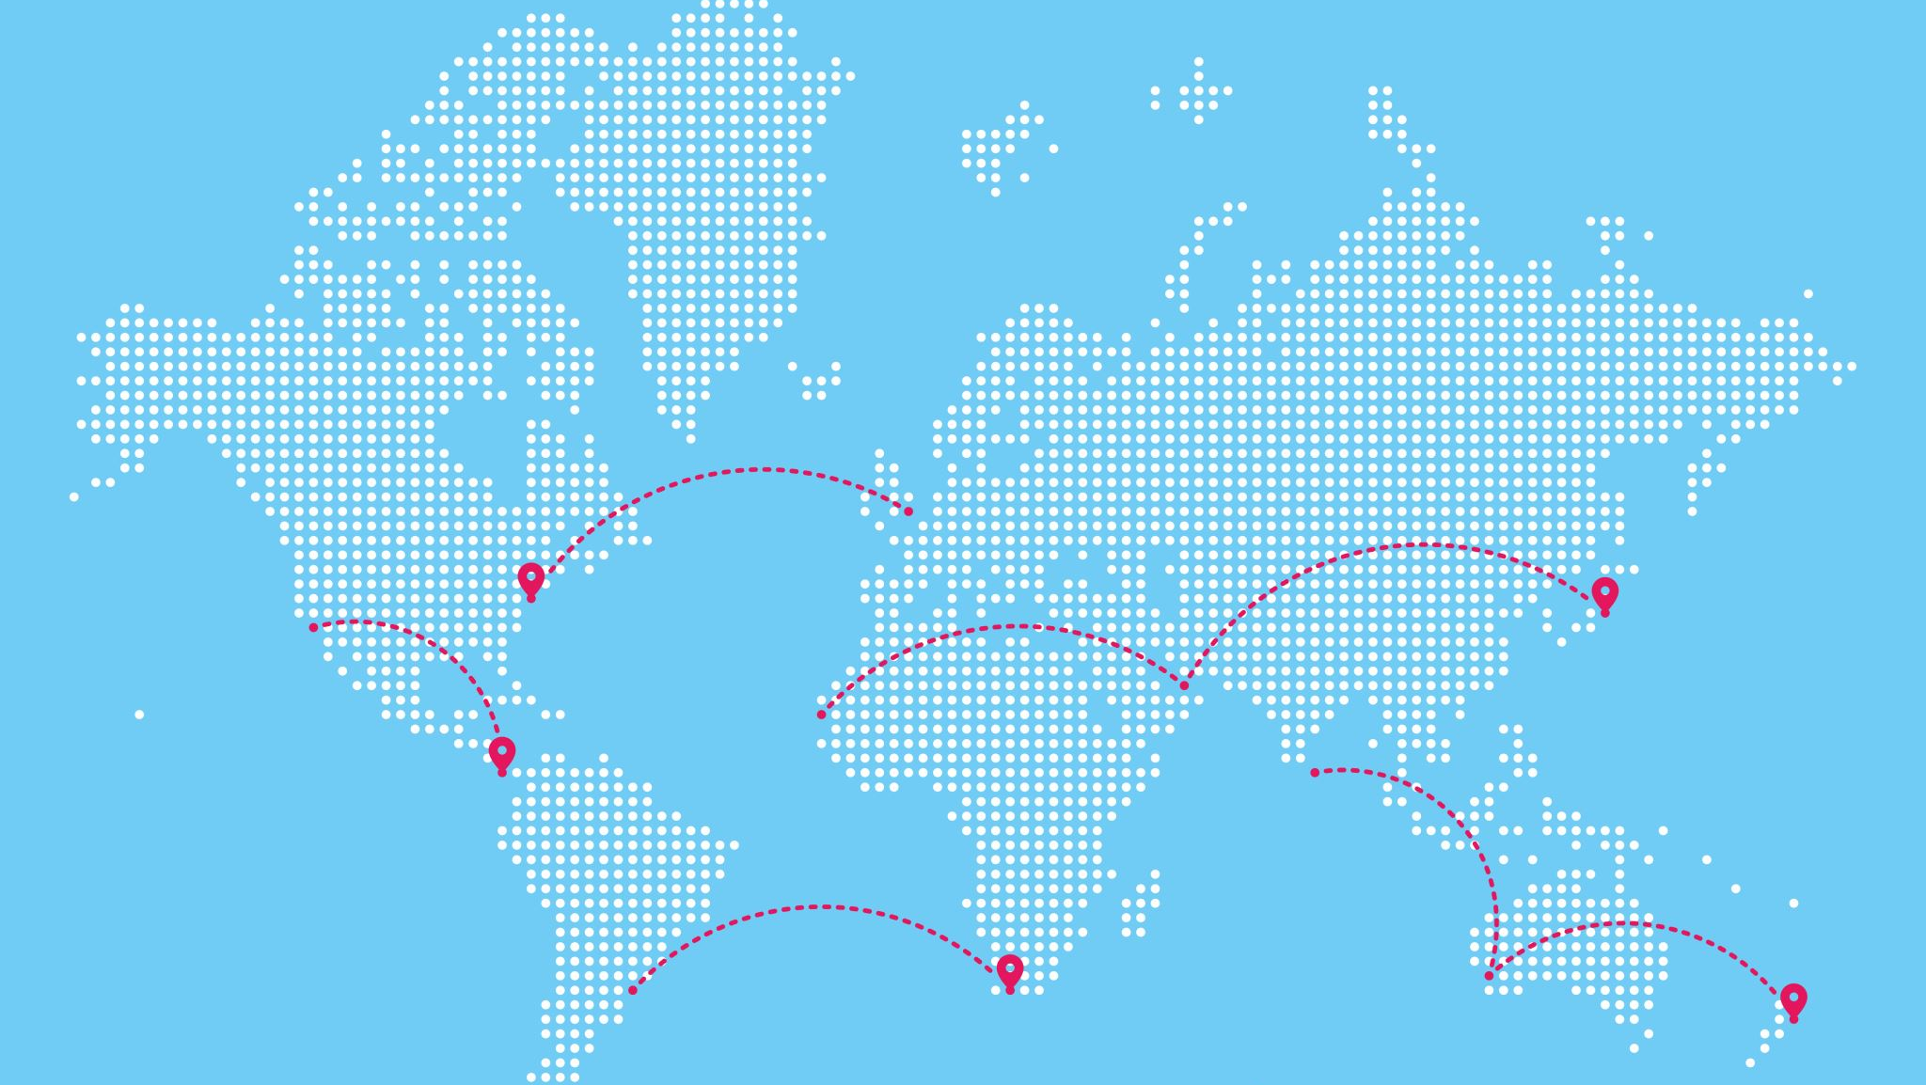
Why Value Stream Mapping (VSM)?
A VSM map makes it easy to visualize a particular process from start to finish.
Teams breakdown their group’s work and associated information flow on a white board so that this is visible
By creating this process map and stepping back for a holistic view, everyone can see the workflow end to end (and often grasp its full scope for the first time).
The purpose is to collectively:
Understand what is our current state (Where are we?)
Where do we want to be ? (Map the path to the ideal TO-BE state)
How should we get there (define the plan of action)

Slide 4

How to Value Stream Map?
Define the Roles and Responsibilities to manage the workshop
Prepare for the workshop (problem statement, goal, deliverables, materials, stakeholders, etc)
Session 1: document the current AS-IS process and measurements
Session 2: analysis and discussions for optimization findings, map the TO-BE state.
Session 3: Playback session, establish governance and plan/prioritise improvements
Outputs
Where are the true bottlenecks ?
identify ways to eliminate waste or non value add activities
Outline potential technology improvements or Opportunities for automation
Charter new breakthrough process redesigns or surface policy changes
Then:
Inject Improvements into backlog and prioritise
Establish a review cadence for continuous improvement

Slide 5
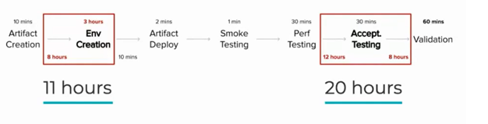
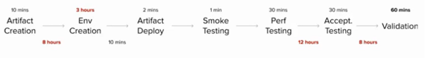
Where are the bottlenecks ??

Slide 6
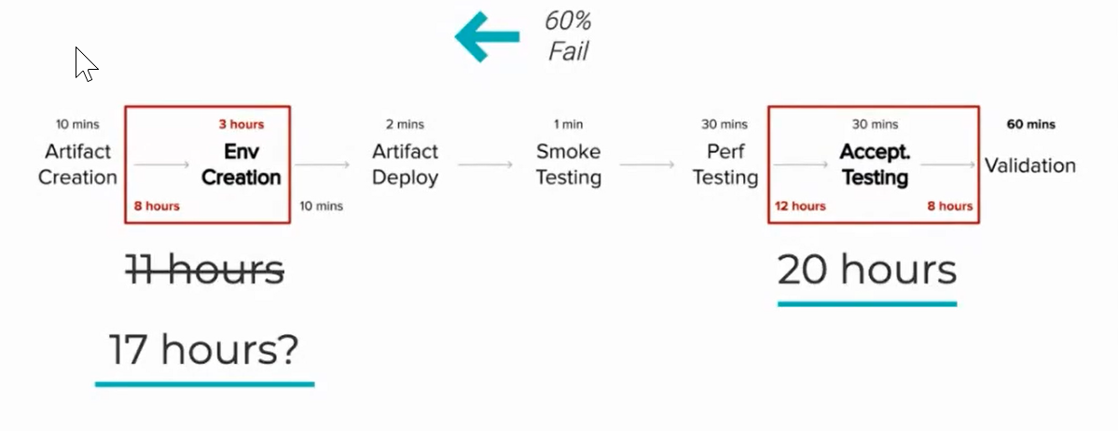
What's next??
Now that we know, we can collectively identify where we should focus and what changes will have most impact:
Identify which bottleneck needs to be addressed first?
Will fixing the bigger bottleneck help?
When is this coming within the process lifecycle?
Will make sense to fix the ones that impacts earlier stages?

Slide 7
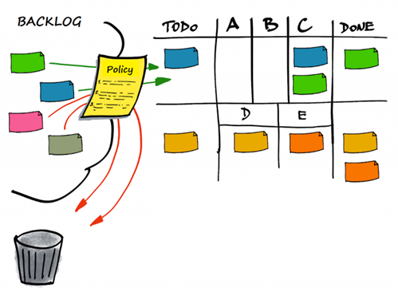
How do we get there??
Now we know, we can identify where we should focus and what has most impact
Create tickets for backlog
Prioritise work
Build the release plan
Communicate and make work visible
Define follow-ups and governance

Slide 8

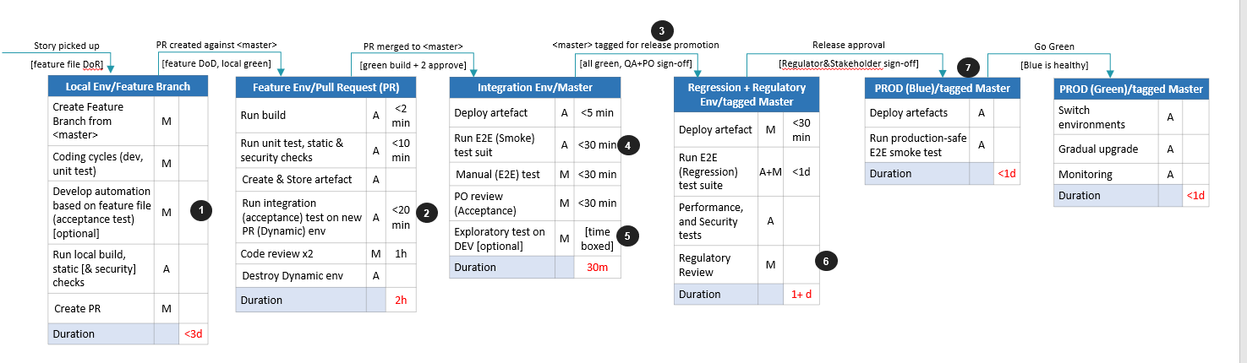
Value Stream Map (example))

Slide 9
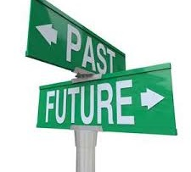


Summary
VSM is a technique that provides a structured visualation that allows us to focus on:
Where are we ?
Looks at identifying what is our current state.
What is the next step
Looks at identifying what are our biggest bottlenecks, pain points or causes of delay.
How should we get there ?
Looks at identifying how we want to operate, what can we do given our current capabilities and what improvement will bring the biggest value.

Slide 10
Q&A

